Slide 1

Moody Grading Data Puzzle
Abdullah Qayyum

Slide 2
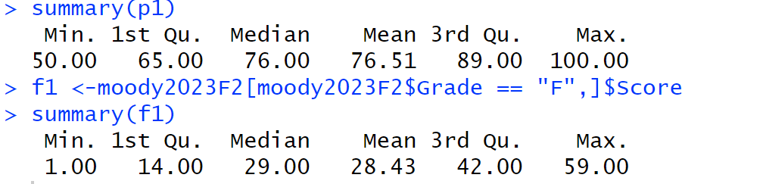
Exploring Factors Affecting Student Scores
Certainly! P1 summarizes students who passed, and F2 summarizes those who failed. Here's the interesting part: someone who scored just 50 passed, while another person who scored as high as 59 failed. This suggests that there must be other factors at play that determine whether a student passes or fails.

Slide 3
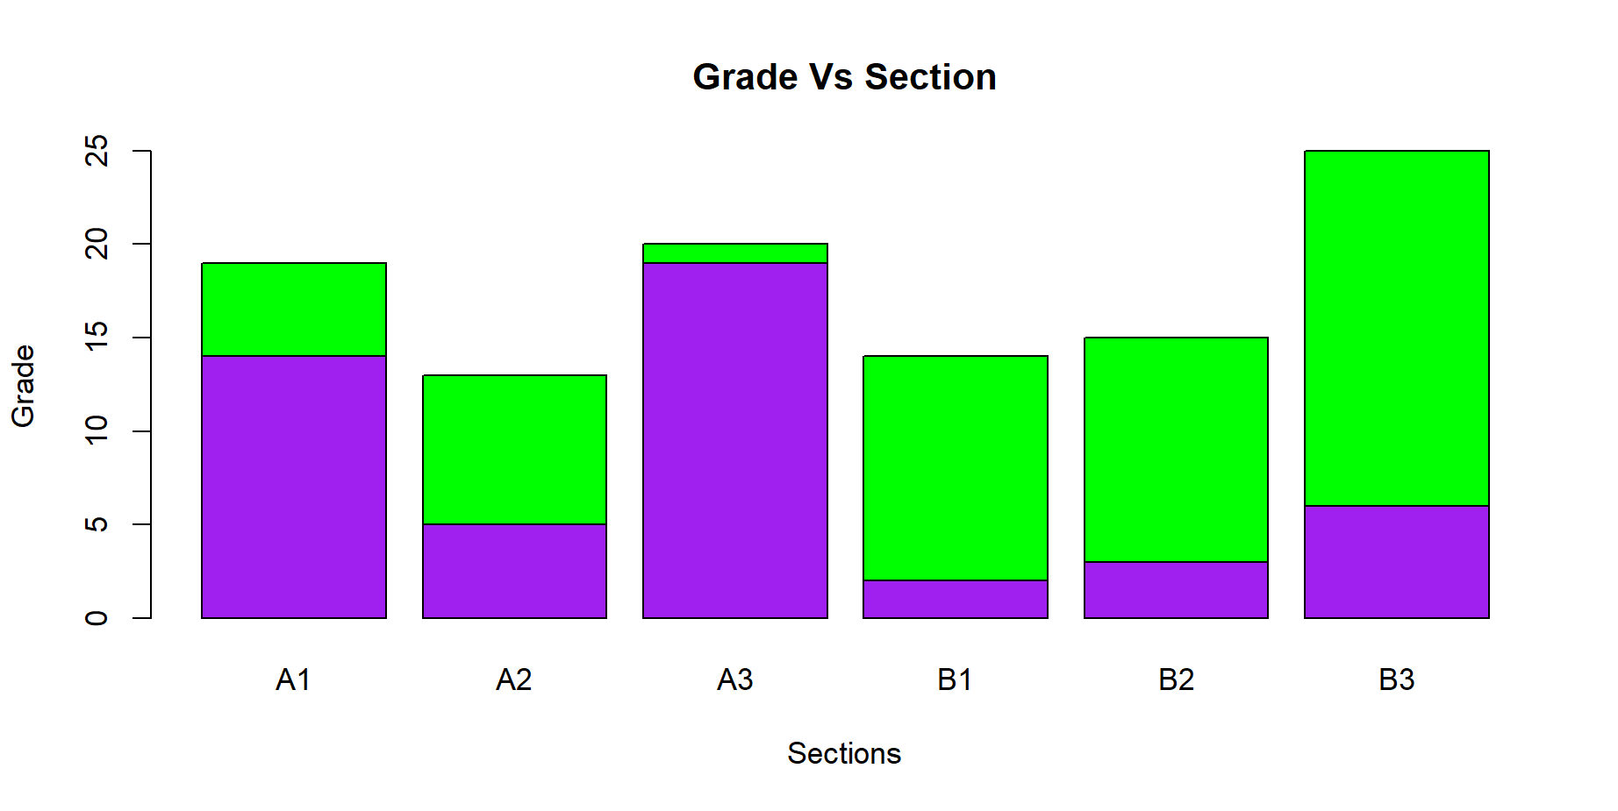
Effect of Section on Pass/Fail
This is the bar graph of the grades of Students between 50 and 59, Since I said earlier that the minimum score that a student got and passed is 50 and the maximum that a student got and failed is 59. So, why is professor moody failing the student with a 59 Score while passing a person with a 50 Score?
The x-axis represents the Sections of the students that scored between 50-59.
The y-axis Represents the Frequency of Pass and Fail.
The purple color represents Students that Failed and the green color represents Passed.

Slide 4
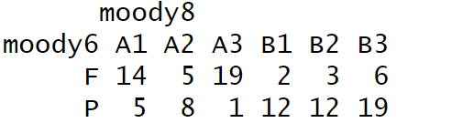
People that Failed were sitting where?
In the bar plot the purple represents the students that passed and green represents the people that failed.
Majority of people that failed were sitting in section A1,A3.
Majority of people that passed were sitting in Sections B1,B2,B3

Slide 5
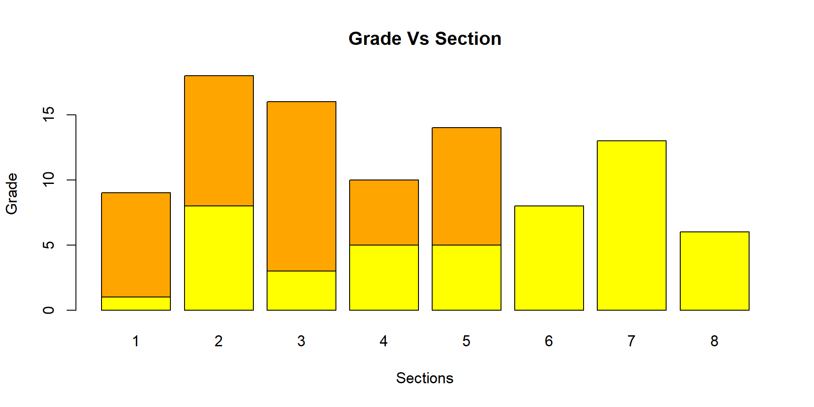
Effect of Sitting Row on Score
This is the bar graph of the grades of Students between 50 and 59.
The Orange color shows people that Passed.
The Yellow color shows people that Failed.
The x-axis show the number of row at which the students are sitting at.
The Y-axis show the frequency of grades pass and fail.
This shows that Majority of students that scored between 50-59 passed were sitting in the first five rows.
So, Professor Moody likes and passes the people that sit at the front. So, Over professor moody does takes # of rows in consideration while pass or failing a Student.

Slide 6
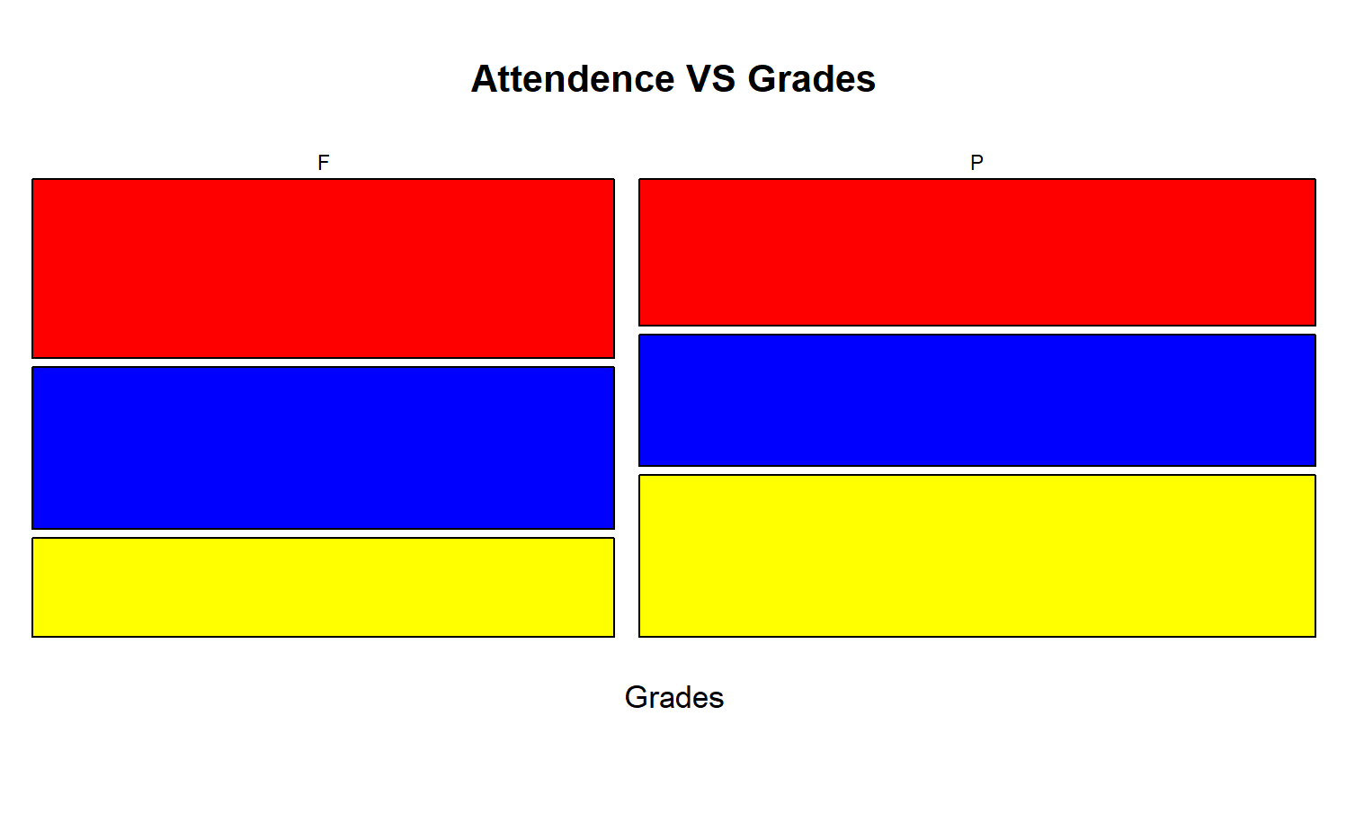
Effect of Attendance of Grades
This graph shows the grades of students who scored between 50 and 59. In the graph, red means high attendance, yellow means medium attendance, and blue means low attendance.
Surprisingly, most of the students who failed had high attendance. On the flip side, most of the students who passed had medium attendance.
It appears that Professor Moody may not consider attendance very important for grading because many students who failed had high attendance and scored over 50.

Slide 7
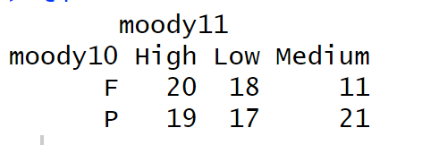
Table of Attendance Vs Grades of Students that Scored Between 50 and 59.

Slide 8

Summary
In summary, to pass the class with Professor Moody, you need a minimum score of 50, and you should sit in the front rows, specifically in B1, B2, or B3 sections. The front five rows are where you should be. If your score is below 59 and you want to pass, following these rules greatly increases your chances of success. It seems that Professor Moody's mood can be quite influential in your academic journey.

Slide 9
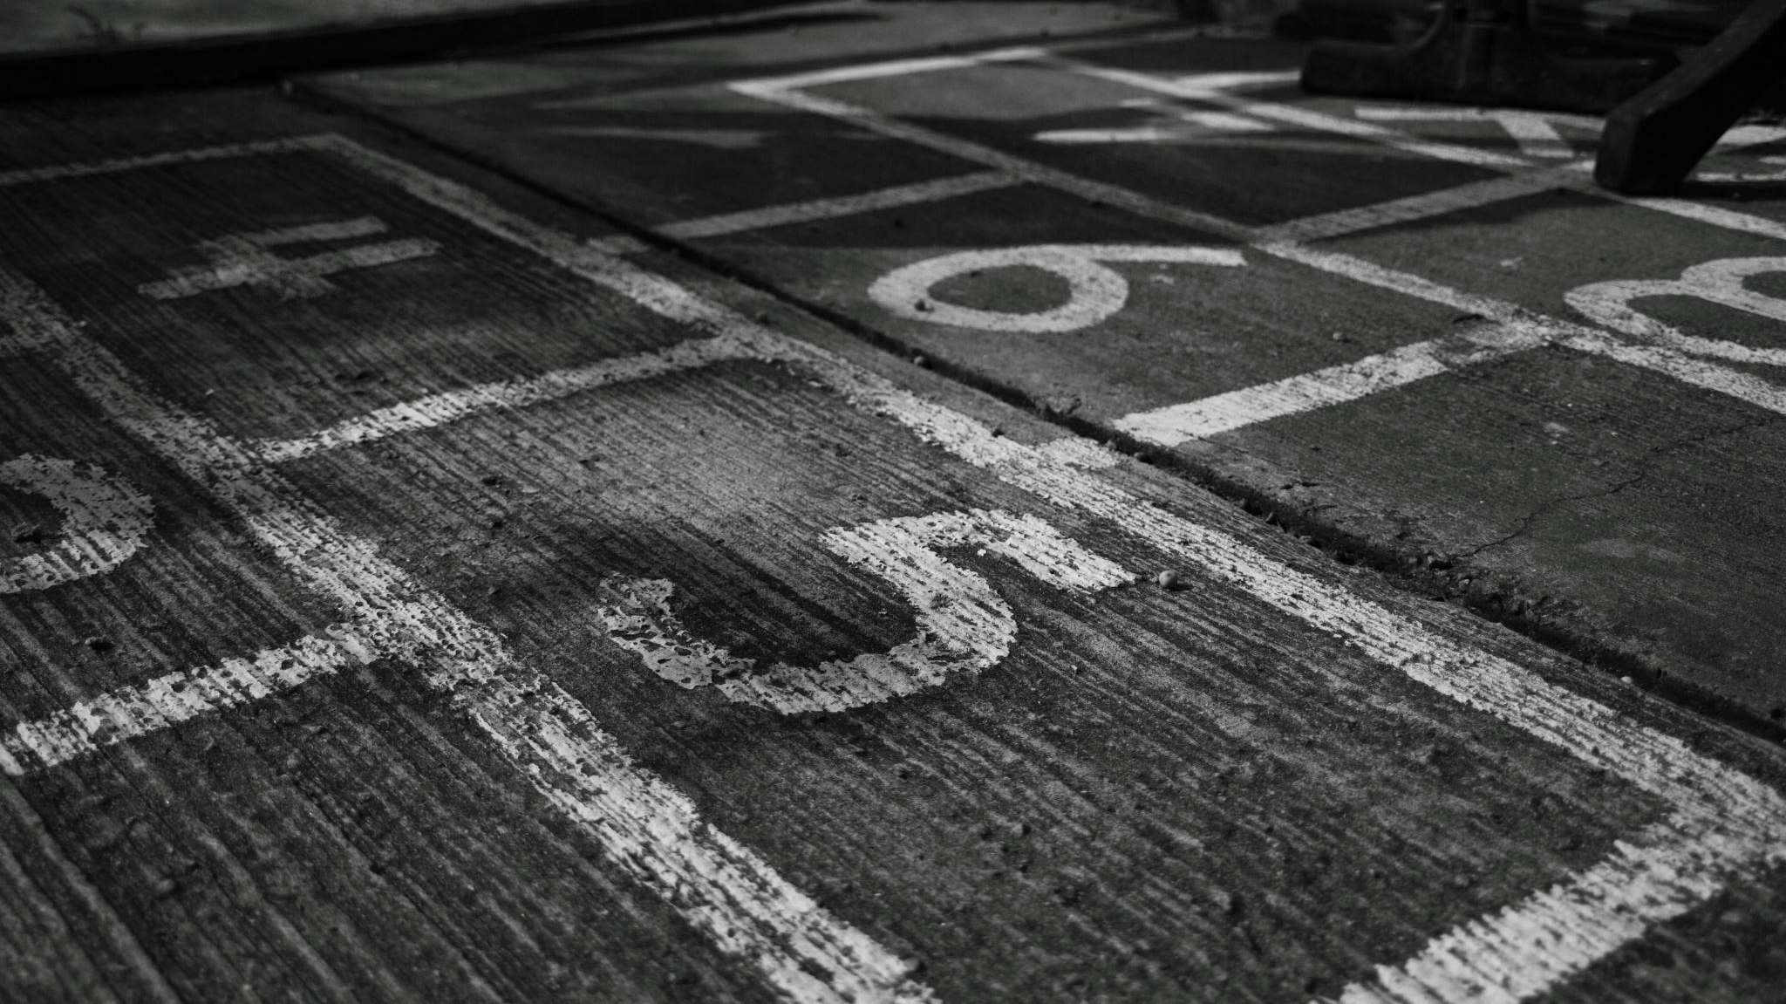
THE END

